Slide 1

Varendra University
Dept. of Computer Science & Engineering (CSE)
The Processor Status and the Flag Register (Chapter-5)
Course Title: Microprocessor and Assembly Language
Course No: CSE 3205
Prepared By:
Md. Adnan Sami
Lecturer, Dept. of CSE, VU

Slide 2
Outline
  Flag Register.
  Overflow.
  How Instructions Affect the Flags.
  Overflow Math.
  Practice Problem.

Slide 3
Flag Register
  For the 8086 processor, the processor state is implemented as nine individual bits called flags.
  Each decision made by the 8086 is based on the values of these flags.
  The flags are placed in the FLAG register and they are classified as either status flags or control flags.
  The status flags reflect the result of a computation.
  The control flags are used to enable or disable certain operations of the processor.

Slide 4
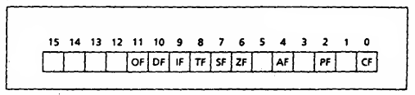
Flag Register
  Flag register are two types,
    Status Flag.
    Control Flag.
  The status flags are located in bits 0, 2, 4, 6, 7, and 11.
  The control flags are located in bit 8, 9, and 10.

Slide 5
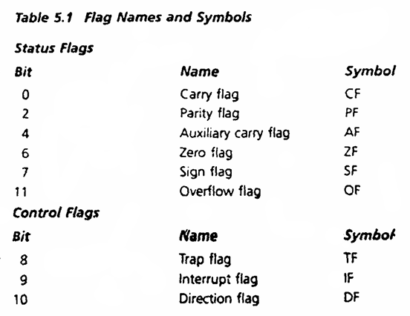
Flag Register

Slide 6
Flag Register
  Status Flag:
  The processor uses status flags to reflect the result of an operation.
  Carry Flag (CF):
  CF = 1, if there is a carry out from the most significant bit (MSB) on addition, or there is a borrow into the MSB on subtraction. Otherwise, it is 0.
  CF is also affected by shift and rotate instructions.

Slide 7
Flag Register
  Parity Flag (PF):
  PF = 1, if the low byte of a result has an even number of one bits (even parity).
  It is 0 if the low byte has odd parity.
  For example,
  If the result of a word addition is FFFEh (1111 1111 1111 1110), then the low byte contains 7 one bits, so PF = 0.
  Auxiliary Flag (AF):
  AF = 1, if there is a carry out from bit 3 on addition, or a borrow into bit 3 on subtraction.
  AF is used in binary-coded decimal (BCD) operations.

Slide 8
Flag Register
  Zero Flag (ZF):
  ZF = 1 for a zero result.
  ZF = 0 for a nonzero result.
  Sign Flag (SF):
  SF = 1, if the MSB of a result is 1 (It means the result is negative)
  SF = 0, if the MSB is 0 .
  Overflow Flag (OF):
  OF = 1, if signed overflow occurred, otherwise it is 0.

Slide 9
Overflow
  Unsigned Overflow:
  On addition, unsigned overflow occurs when there is a carry out of the MSB.
  On subtraction, unsigned overflow occurs when there is a borrow into the MSB.

Slide 10
Overflow
  Signed Overflow:
  On addition of numbers with the same sign, signed overflow occurs when the sum has a different sign. For example, when we add 7FFFh and 7FFFh (two positive numbers), but got FFFEh (a negative result).
  Subtraction of numbers with different signs is like adding numbers of the same sign. For example, A - ( -B) = A + B and -A -(+B) = -A + -B. Signed overflow occurs if the result has a different sign than expected.
  In addition of numbers with different signs, overflow is impossible.

Slide 11
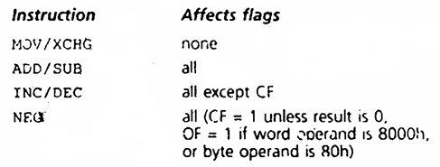
How Instructions Affect the Flags

Slide 12
Overflow Math
Follow Class Note

Slide 13
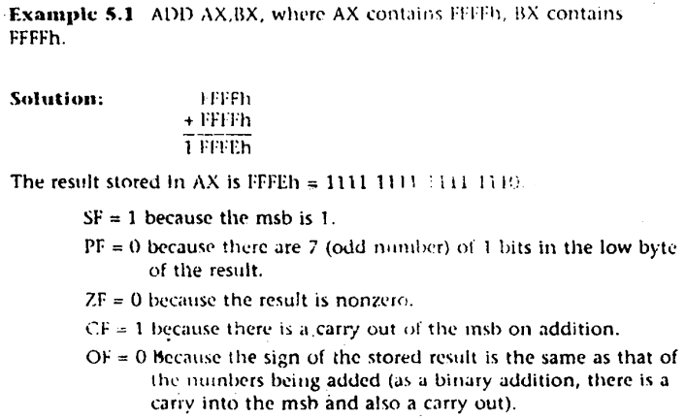
Practice Problem
  Example 5.1:

Slide 14
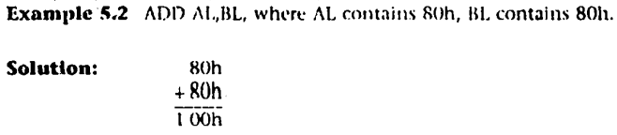
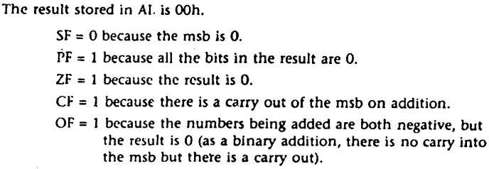
Practice Problem
  Example 5.2:

Slide 15
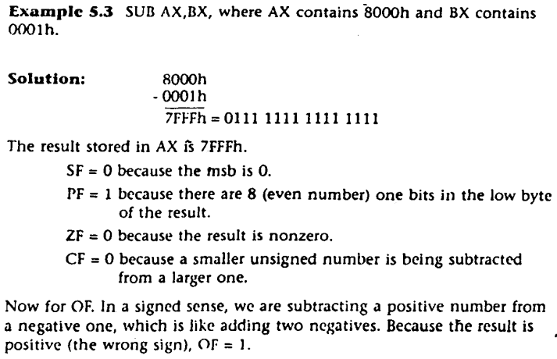
Practice Problem
  Example 5.3:

Slide 16
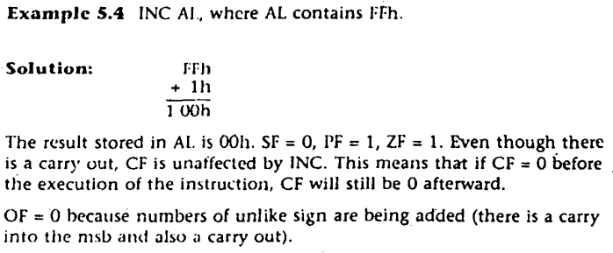
Practice Problem
  Example 5.4:

Slide 17
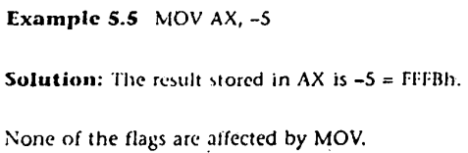
Practice Problem
  Example 5.5:

Slide 18

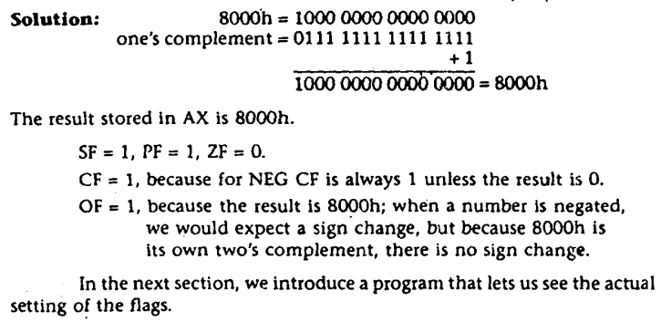
Practice Problem
  Example 5.6:

